Slide 1
Spotting “Fake” News and Images on the Web
Teacher Name
Date

Slide 2
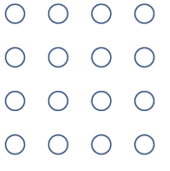
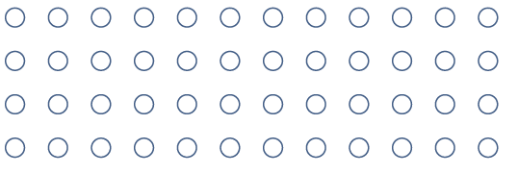
Learning Goals
Understand why it’s important to question the truthfulness of articles and images found on the web
Define confirmation bias and recognize how it impacts a person’s decision-making
Develop strategies for identifying “fake” news and images

Slide 3
Class Discussion
What are the different ways we experience the news?

Slide 5
How can the spread of misinformation have negative consequences?
Scenario #1: “News” reports tell of alleged gas shortage in the wake of Hurricane Harvey
(Category 4 tropical cyclone that hit Texas and Louisiana in August 2017)
Small Group Discussion

Slide 6
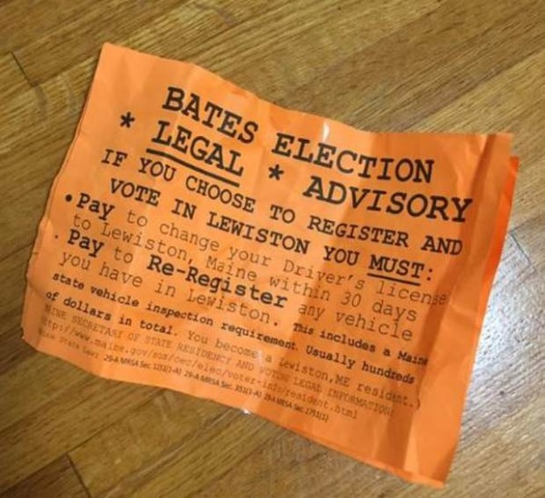
Small Group Discussion
How can the spread of misinformation have negative consequences?
Scenario #2: Orange “legal advisory” flyers distributed on the Bates College campus in Maine only days prior to the 2016 election told students that if they wanted to vote in Lewiston, they would have to pay to change their driver’s licenses and to re-register any vehicle in the city.

Slide 7
How can the spread of misinformation have negative consequences?
Scenario #3: You hear a rumor about a classmate at school and tell it to several others. You later learn the rumor is not true, but you had a hand in spreading it around school.
Small Group Discussion

Slide 8
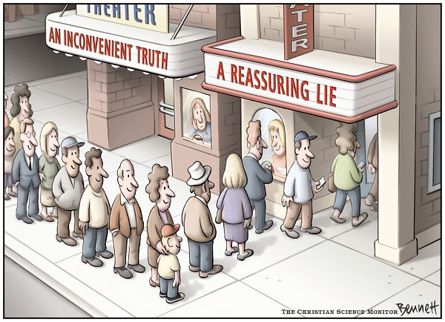
Confirmation bias
The natural tendency to seek out or favor information that confirms what you already believe to be true while at the same time ignoring evidence that contradicts your beliefs.

Slide 9
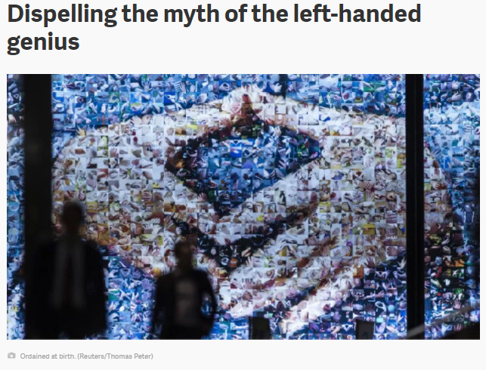
Confirmation bias
Which article would you share on social media if you believed left-handed people are more creative than right-handed people?
ARTICLE B
ARTICLE A

Slide 10
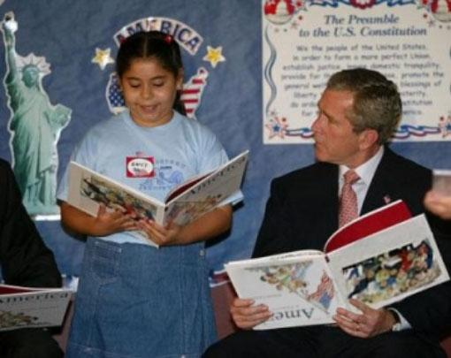
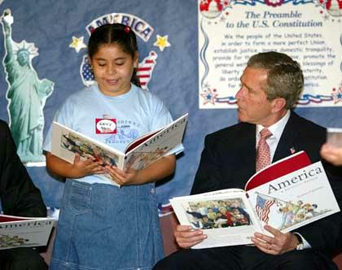
Evaluating the credibility of images

Slide 11
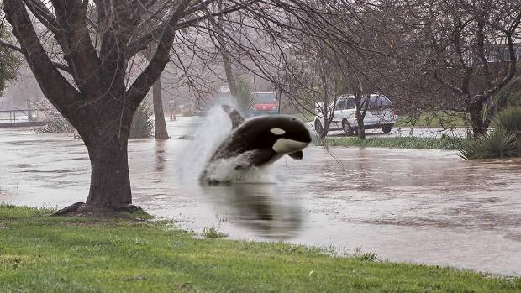
Evaluating the credibility of images
Photoshopped image of orca swimming in flood waters near Christchurch, New Zealand

Slide 12
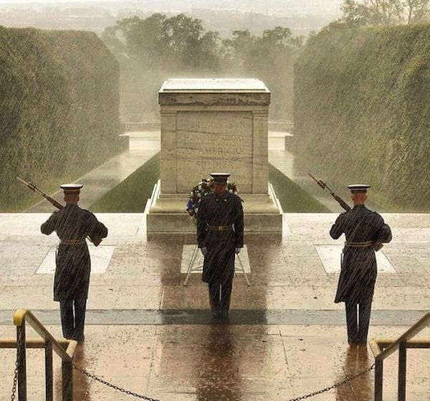
Evaluating the credibility of images
Tomb of the Unknown Soldier
This image was circulated on social media and in news stories as being taken during Hurricane Sandy, but the photo was actually taken during a different rain storm.

Slide 13
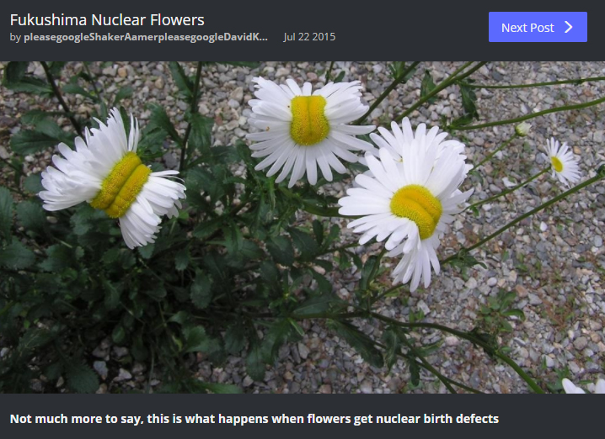
Evaluating the credibility of images
You are doing a research paper on the effects of nuclear radiation, and you stumble upon this picture posted on a photo sharing site (Imgur).
How could you find out whether this image is making a true or false claim?

Slide 14
AI-Generated Art
Creative works produced with the assistance of artificial intelligence (AI) algorithms, using machine learning and deep learning techniques to analyze patterns and generate new visual, audio or textual content.
“Deepfake” refers to the more malicious use of deep learning algorithms to create highly realistic fake audio, video or images, often portraying individuals saying or doing things they never did.

Slide 15
Zoom in. Look for stray pixels, odd outlines, blurry faces and misplaced shapes.
Look for inconsistencies, such as earrings that don’t match or extra fingers or teeth!
Scan the background. (It’s often blurry.) Do signs, text, objects, or topographical features seem distorted?
Ask yourself, “Is this image too perfect to be real?” Many AI-generated images are overly glossy or artistic-looking.
How to Spot AI-Generated Images

Slide 16
6. Use the SIFT approach.
Stop.
Investigate the source.
Find better coverage.
Trace the original context.
7. Conduct a reverse image search.
This site can also help you determine whether an image has been generated by AI or a human, but keep in mind these tools are not always reliable: https://www.aiornot.com/
How to Spot AI-Generated Images

Slide 17
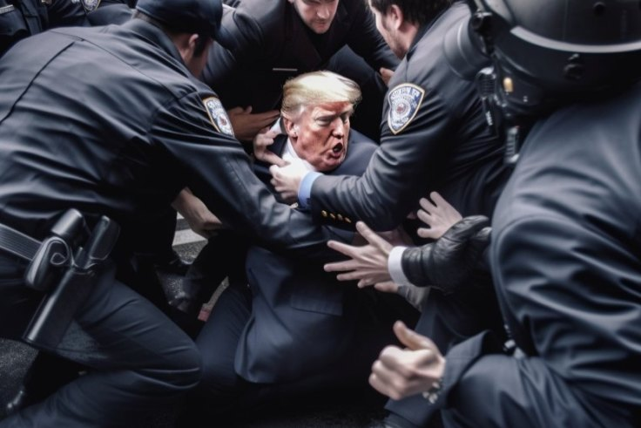
Images Generated by Artificial Intelligence
AI-generated images of Trump’s arrest in NYC and a shouting Melania. These images were widely shared in March 2023 before Trump’s actual arrest.
Anything look weird to you?

Slide 18
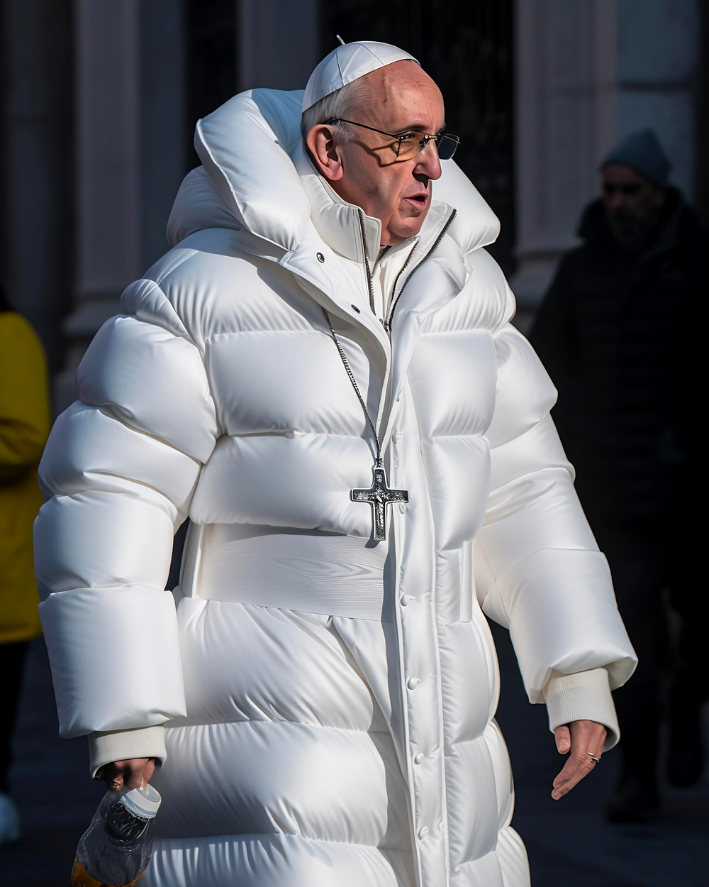
Images Generated by Artificial Intelligence
AI-generated image of Pope Francis in a white Balenciaga puffer coat.
What are the giveaways that this image is a fake?

Slide 19
Test yourself. Take the quiz!
How to Spot AI-Generated Images and Deepfakes

Slide 20
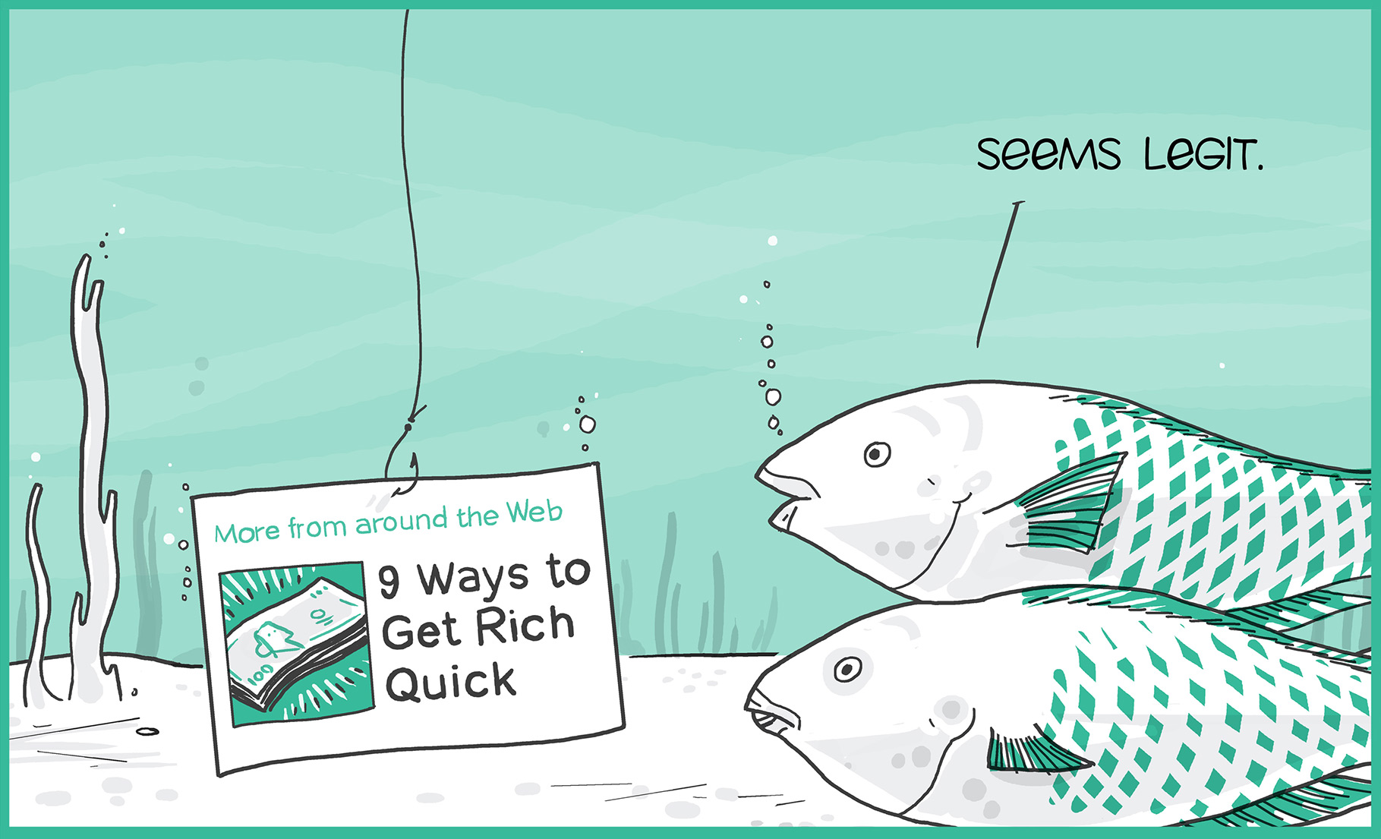
Clickbait
Catchy headlines and/or images designed to grab your attention and encourage you to click through to an article or website that may contain questionable content.
Sometimes clickbait is ad content disguised to look like a legitimate news article.

Slide 21
Legitimate News or Clickbait? Using the SMART Board, draw a line from the headline to News or Clickbait.
12 Unusual Ways Celebrities Hydrate Their Skin
News
Avoid a Holiday Health Crisis
The Economy Is Humming, but Businesses Aren't Borrowing
Clickbait
World’s Oldest Woman Reveals the One Food She Eats Every Day

Slide 22
Tips for Recognizing “Fake” News and Images
Before you cite or share:
Read beyond the headline
Consider the source
Check the author/photographer
Check the date
Check the links

Slide 23
Information Literacy Resources
Before you cite or share:
Check the comments
Evaluate supporting quotes
Ask: “Is this a joke?” (satire) — The Onion, The Daily Current, Empire News
Ask: “Do my own beliefs affect my judgment?” (confirmation bias)
Follow the SIFT approach or conduct a reverse image search

Slide 24
Resources
Handout:
Fact or Fiction? 10 Tips for “Ferreting Out” Fake News (also available in 11x17 poster)
Fact-checking websites:
FactCheck.org
Politifact.com
Snopes.com
Test your news sense:
https://newslit.org/tips-tools/how-news-literate-are-you-quiz/

Slide 25
Due Tomorrow: How does the spread of misinformation (including fake news and images) relate to research? Write a well-developed paragraph of 6-8 sentences and post to the class blog. Respond to at least two of your classmates’ posts by Friday.
Discussion
Post
Up Next:
Evaluating Web Sources Using the CRAAP Test
Introduction to Library Databases (Yay!)

Slide 26
Sources
Bennett, C. (2006, May 30). An inconvenient truth [Photo]. The Association of American Editorial Cartoonists.
Bond, S. (2023, June 13). AI-generated images are everywhere. Here’s how to spot them. NPR. Retrieved from https://www.npr.org/2023/06/07/1180768459/how-to-identify-ai-generated-deepfake-images
Fukushima nuclear flowers [Photo]. (2015). Retrieved from https://imgur.com/gallery/BZWWx
IFLA. (2016). How to spot fake news [Infographic]. Retrieved from https://www.ifla.org/publications/node/11174
Kline, K. (2017). Spectrum of news sources [Infographic]. UC Merced Library. Retrieved from http://libguides.ucmerced.edu/elevate-news-evaluation/spectrum
Ovide, S. (2023, March 31). How to spot the Trump and Pope AI fakes. The Washington Post. Retrieved from https://www.washingtonpost.com/technology/2023/03/31/tips-spot-ai-fake-images/
Sharethrough. The true cost of clickbait [Photo]. (2015, August 12). Retrieved from https://www.sharethrough.com/blog/the-true-cost-of-clickbait
Steele, C. (2023, August 30). How to detect AI-created images. PC Magazine. Retrieved from https://www.pcmag.com/how-to/how-to-detect-ai-created-images
US Army. (2012). Despite Sandy, Soldiers Stand Guard at Tomb of the Unknown Soldier [Photo]. NPR. Retrieved from https://www.npr.org/sections/thetwo-way/2012/10/29/163875922/photo-despite-sandy-soldiers-stand-guard-at-tomb-of-the-unknown-soldier
Webber, S. (2017, July 25). Christchurch photographer Sarah Webber's photoshopped flood pictures [Photo]. Stuff. Retrieved from https://www.stuff.co.nz/national/95074888/Christchurch-photographer-Sarah-Webbers-photoshopped-flood-pictures

