Slide 1


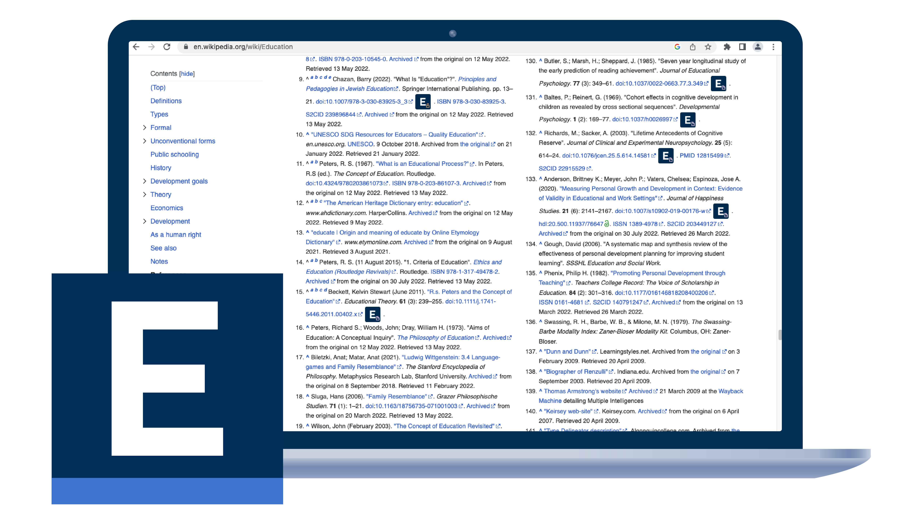
EBSCOhost Passport™
Access your Library’s full-text articles from directly on the internet via our NEW, FREE browser extension!

Slide 2

Do you use Google Scholar, PubMed and/or Wikipedia for Research?
If so, did you know you can now directly access your organisations online, full-text content from the Library, simply by setting up our new browser extension in less than 3 minutes?
Our FREE & NEW browser extension tool ‘EBSCOhost Passport’ allows you to seamlessly access your Library’s range of full-text articles, by providing an ‘E’ icon that can load the PDFs directly within those environments, saving you both time and effort in the future!

Slide 3
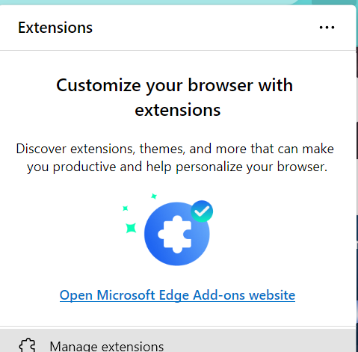
Installing EBSCOhost Passport for Microsoft Edge
Open Google Chrome and click on the 3 horizontal dots in the top right of the screen.
Select 'Extensions' from the drop-down menu, then click the ‘Open Microsoft Edge Add-ons website'.

Slide 4
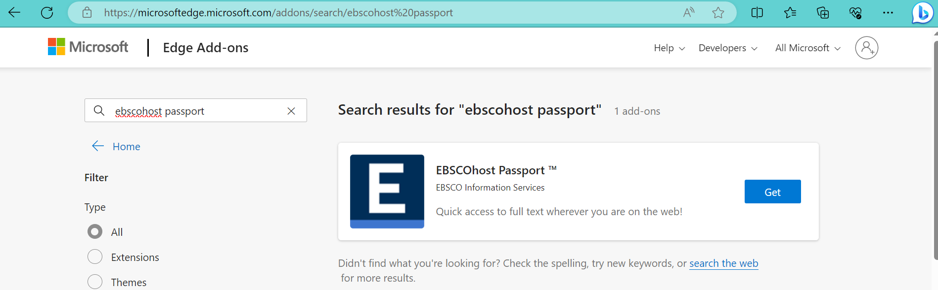
Installing EBSCOhost Passport for Microsoft Edge
Type in ‘ebscohost passport’ into the search box in the far left as per the screenshot below and then click on the blue ‘Get’ in the box for EBSCOhost Passport.

Slide 5
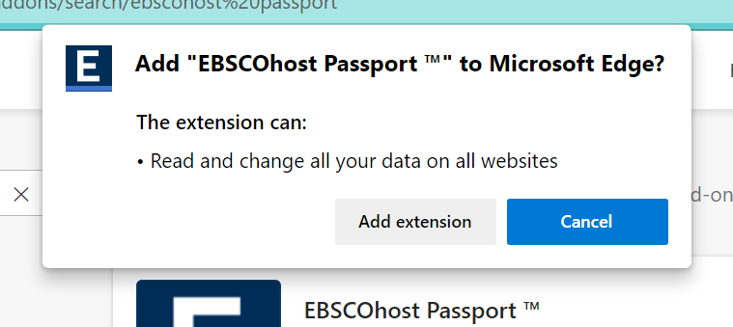
Installing EBSCOhost Passport for Microsoft Edge
Click the ‘Add Extension’ button on the popup window that appears as per the image to the right.

Slide 6
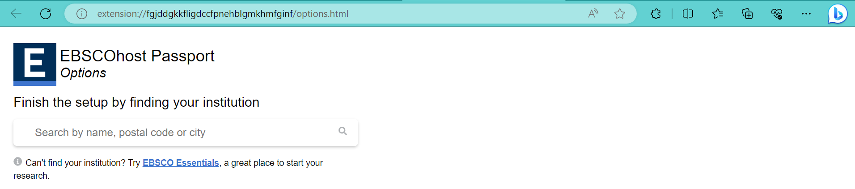
Installing EBSCOhost Passport for Microsoft Edge
Enter your University/College/Corporate organisation name in the search box ‘Search by name, postal code or city…..’ then click the magnifying glass icon on the right of that search box, followed by clicking on the organisation name you are connected to that is presented in the list immediately below the search box.

Slide 7
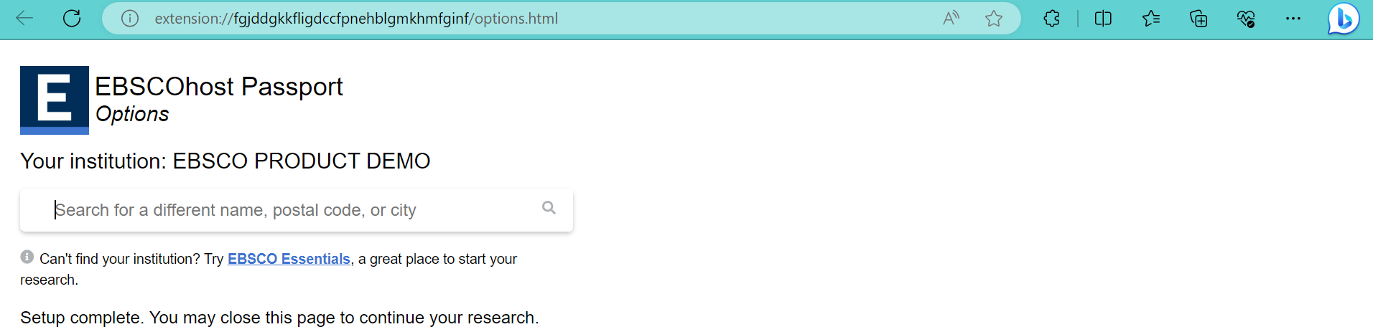
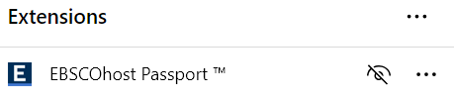
Installing EBSCOhost Passport for Microsoft Edge
Click the ‘jigsaw’ looking icon to the right of the star in the top toolbar, then click the ‘Eye’ looking icon so it removes the diagonal line and adds a blue ‘E’ icon to your toolbar.

Slide 8
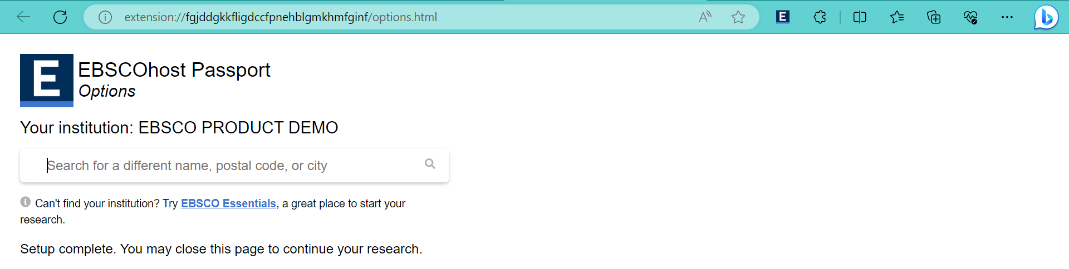
Installing EBSCOhost Passport for Microsoft Edge
An ‘E’ icon is now added to your browser and is now setup to use!
For a help guide and further information on EBSCOhost Passport, please see
our short 2-minute tutorial video by clicking here: https://youtu.be/wGi6BoD3pwk or contact your Library for further information.

Slide 9
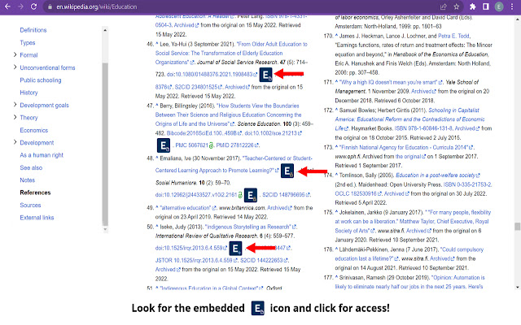
EBSCOhost Passport Example – Wikipedia
Now look for the ‘E’ icon, in-context on
the page and click to access the full-text article, or on the right-hand side to indicate access is available through your institution or freely available as Open Access.
If you liked this, have you tried our
FREE ‘EBSCO’ Mobile App yet? If not head to the App Store / Google Play
today and easily access full-text content on-the-go, especially when you’re not
at the Library/your desk or office!
EBSCOhost Passport –
Browser Extension Demo

